Slide 1
How Arguments Work: A Guide to writing and analyzing texts in college
Chapter 4: Assessing the Strength of an Argument
Sections 4.2-4.5

Slide 2
Attributions and Licensing
This slide presentation accompanies How Arguments Work: - A Guide to Writing and Analyzing Texts in College by Anna Mills.
These Chapter 4 slides by Natalie Peterkin are licensed CC BY-NC 4.0.
This project is sponsored by ASCCC OERI.

Slide 3
Content Overview
4.2: Check If the Meaning Is Clear
4.3: Look for Exceptions
4.4: Decide How Strong the Evidence Is
4.5: Check the Argument's Assumptions

Slide 4
Checking if the Meaning is Clear
Sometimes we can identify the point a writer is trying to make, but major questions still remain about what the writer means. Such critique can point out the ambiguity--the many possible meanings of some part of the argument.
Phrases for pointing out what is not clear
We do not need any special vocabulary to point out ambiguity, but sometimes seeing typical phrases can help jumpstart our thinking. Here are some approaches:
Ask a question
What exactly does she mean by _____________?
Describe the author’s actions and shortcomings
He seems to imply that _____________, but leaves ambiguous whether or not that means_____________.
They fail to clarify what exactly _____________ refers to.
He does not define what he means by _____________.
She explores _____________, but fails to articulate a clear message.
Refer to the argument’s failure to clarify
This leaves open the question of _____________.
The argument never specifies whether _____________ or _____________.
Refer to readers’ probable confusion
Readers will wonder if they mean_____________ or _____________.
Readers may be confused by the shifting meaning of the term “_____________.”
Many will interpret _____________ to mean _____________, but some might also take it to mean _____________.

Slide 5
Practice
Suggested Short Readings
“Must the President Be a Moral Leader?” by Michael Blake (69-73). Michael Black explores how a President’s character and virtues may impact leadership. However, the differences between right and wrong are blurred in the world of politics.
“Coronavirus closures could lead to a radical revolution in conservation” by James Stinson and Elizabeth Lunstrum. This piece explores the tensions between the needs of wildlife and our desire to promote park visitation as a way to increase human health. It suggests that we shift our paradigm and think about balancing these goals to promote “planetary health.”
Or, find other argumentative readings to choose from.
Pick an ambiguous or unclear argument from a class reading or one of the suggested links. Then, use a strategy from the previous slide to point out why it’s unclear.

Slide 6
Look for exceptions
We can check an argument by looking for possible exceptions to any generalization it makes.
Is it true in all cases, or can we identify any case that doesn’t fit the pattern?
Sample phrases for pointing out exceptions:
The argument is based on the idea that _____________, but this is not entirely true because _____________.
The reason given is that _____________, but the author has not considered the possibility that, in fact, _____________.
The author does not acknowledge that _____________ might be the case.

Slide 7
Decide how strong the evidence is:
Is there enough evidence?
Is the evidence trustworthy?
Can it be verified?
Is the evidence from trustworthy sources or experts?
If it is from experts, who are these experts? Can we trust them?
Is the evidence biased?
Does it try to promote a particular product or ideology?
Do experts in the field review its studies?
Is there enough variety in the evidence?
Image by Lutz Peter from Pixabay under the Pixabay License.

Slide 8
Check the Assumptions
“One of the most powerful techniques for testing whether an argument is valid is to find out what assumptions it makes and check those assumptions. Noticing and questioning assumptions is a core slow thinking practice in college. Beyond that, questioning assumptions may be one of the most powerful mental habits a human can learn.” -- How Arguments Work

Slide 9
Identifying Assumptions
The basic method is to ask ourselves what the reason needs to support the claim.
What other idea is necessary for us to make the leap from reason to claim?
What underlying idea does that leap depend on?

Slide 10
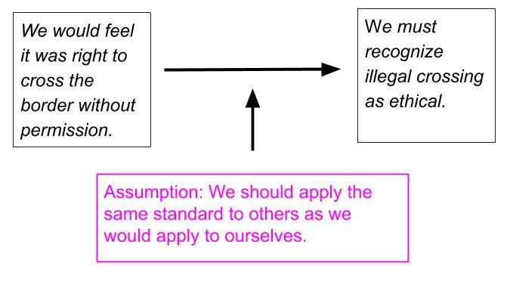
Sample Map of a Claim, Reason, and Associated Assumption
Text description of argument assumption map

Slide 11
The scenario test
The scenario test is a simple way to help us identify exceptions and assumptions. If you find a reason give for a claim, see if you can imagine a case where the reason is true and the claim isn’t.
Just because _____________
doesn’t mean that _____________
because it could be that _____________.

Slide 12
The scenario test--example
1. Let’s say we try the scenario test with the border argument claim and reason, and come up with this:
“Just because we would feel it was right to cross the border without permission doesn't necessarily mean that we must recognize illegal crossing as ethical because it could be that our personal feelings are not always the best guide to ethics.”
2. This helps us identify an assumption needed to link the claim and reason:
Assumption: We can tell if something is ethical by whether or not it feels right.
3. Now we can consider whether this assumption is valid or needs support or further explanation.

Slide 13
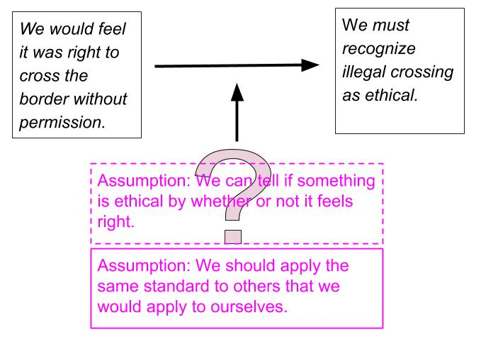
Sample map showing a questionable assumption
Text description of the quesitonable assumption map

Slide 14
Make your own assumption map
In groups, open the Google Drawing assumption template to map out one claim, one reason, and the assumption they depend on.
Select “File,” then “Make a copy” to create your own map.

