Slide 1
How Arguments Work: A Guide to writing and analyzing texts in college
Chapter 3: Writing a Summary of Another Writer’s Argument

Slide 2
Attributions and Licensing
This slide presentation accompanies How Arguments Work: - A Guide to Writing and Analyzing Texts in College by Anna Mills.
These Chapter 3 slides by Natalie Peterkin are licensed CC BY-NC 4.0.
This project is sponsored by ASCCC OERI.

Slide 3
Content Overview
3.1: What Is a Summary
3.2: Introducing the Argument and the Main Claim
3.3: Describing the Reasoning
3.4: Describing How the Author Treats Counterarguments
3.5: Describing How the Author Limits the Claim
3.6: Putting the Summary Together
3.7: Writing a Short Summary of a Long Argument

Slide 4
Introducing the Argument
Almost immediately, readers of any summary will need some basic information about the argument summarized.
Some options for introductory phrases include the following:
In an article for _____________, writer _____________...
The account of _____________ in the piece _____________ by _____________...
Writing in the journal _____________, the scholar _____________ ...

Slide 5
Describing Claims of Fact
Early on…
Phrases to introduce controversial claims of fact
Phrases to introduce widely accepted claims of fact
Within the first paragraph of your summary, describe the main claim of the argument you are summarizing.
They argue that _____________.
She maintains that _____________.
He contends that _____________.
They assert that _____________.
She holds that _____________.
He insists that _____________.
She thinks_____________.
They believe that_____________.
He informs us of _____________.
She describes_____________.
They note that _____________.
He observes that _____________.
She explains that _____________.
The writer points out the way in which_____________.

Slide 6
Describing Claims OF VALUE
Phrases to describe a positive claim of value
They praise_____________.
He celebrates_____________.
She applauds the notion that_____________.
He admires_____________.
She finds value in_____________.
They rave about_____________.
Phrases to describe a negative claim of value
The author criticizes_____________.
He finds fault in_____________.
They regret that_____________.
They complain that_____________.
The authors are disappointed in_____________.
Phrases to describe a mixed claim of value
The author gives a mixed review of_____________.
She sees strengths and weaknesses in_____________.
He praises_____________ while finding some fault in _____________
The authors have mixed feelings about_____________. On the one hand, they are impressed by_____________, but on the other hand, they find much to be desired in_____________.

Slide 7
Describing Claims OF POLICY
Phrases to describe a strongly felt claim of policy
They advocate for_____________.
She recommends_____________.
The writers urge_____________.
The author is promoting_____________.
He calls for_____________.
She demands_____________.
Phrases to describe a more tentative claim of policy
He suggests__________.
The researchers explore he possibility of__________.
They hope that__________can take action to__________.
She shows why we should give more thought to developing a plan to__________.
The writer asks us to consider__________.

Slide 8
Describing the REASONING
In a summary, readers will want to know not just what the argument is claiming but how it supports that claim.
Common Phrases for Describing the Reasoning
She reasons that _____________.
He explains this by_____________.
The author justifies this with_____________.
To support this perspective, the author points out that_____________.
The writer bases this claim on the idea that_____________.
They argue that_____________ implies that _____________ because_____________.
She argues that if _____________, then _____________.
He claims that _____________ necessarily means that_____________
She substantiates this idea by_____________.
He supports this idea by_____________.
The writer gives evidence in the form of_____________.
They back this up with_____________.
She demonstrates this by_____________.
He proves attempts to prove this by _____________.
They cite studies of _____________.
On the basis of _____________, she concludes that _____________.

Slide 9
Describing the TREATMENT OF Counterarguments
If the Author Sees Some Merit in the Counterargument
The writer acknowledges that _____________, but still insists that _____________.
They concede that _____________; however they consider that _____________.
He grants the idea that _____________, yet still maintains that _____________.
She admits that _____________, but she points out that_____________.
The author sees merit in the idea that _____________, but cannot accept_____________.
Even though he sympathizes with those who believe _____________, the author emphasizes that _____________.
If the Author Rejects the Counterargument Entirely
She refutes this claim by arguing that _____________.
However, he questions the very idea that _____________, observing that _____________.
She disagrees with the claim that _____________ because _____________.
They challenge the idea that _____________ by arguing that _____________.
He rejects the argument that_____________, claiming that _____________.
She defends her position against those who claim _____________ by explaining that _____________.

Slide 10
Describing THE Limits
He qualifies his position by_____________.
She limits her claim by_____________.
They clarify that this only holds if _____________.
The author restricts their claim to cases where_____________.
He makes an exception for_____________.

Slide 11
Putting the Summary Together
Sample Summary:
In her 2019 article “Wouldn’t We All Cross the Border?”, Anna Mills urges readers to seek a new border policy that helps desperate undocumented migrants rather than criminalizing them. She calls for a shift toward respect and empathy, questioning the very idea that crossing illegally is wrong. Mills argues that any parent in a desperate position would consider it right to cross for their child’s sake; therefore, no person should condemn that action in another. Since we cannot justify our current walls and detention centers, we must get rid of them. She acknowledges that opening the borders completely would compromise security, but believes that we can still “regulate” our borders without blocking or imprisoning migrants.
By introducing each part of the argument to show how it relates to the others, we have already provided many of the transitions we need for a good summary.
We can generate a first draft of the summary by simply putting them all together in order.

Slide 12
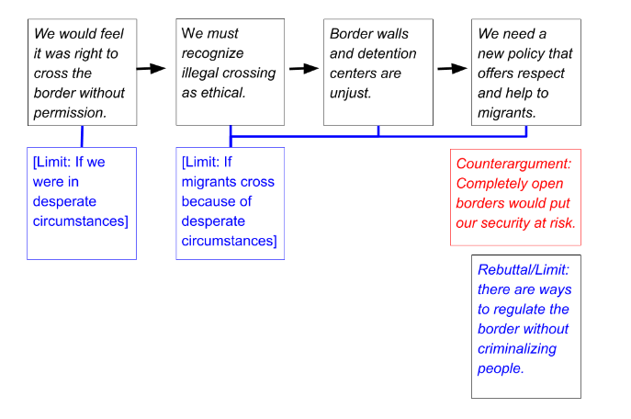
Use an Argument Map to Check the Summary
Next, we can review our border argument map to make sure that we have covered the main parts of the argument.
The map and our knowledge of the role of each part of the argument will help us organize the essay into paragraphs.
Text description of an argument map showing limits

Slide 13
Sample Summaries
See 3.8: Sample Summaries for annotated examples.

